Slide 1
Multiplicative relationships and direct proportion
Task A: Direct proportion
1) Which of the following show a directly proportional relationship between A and B?
a)
A | B
3 | 12
6 | 24
8 | 32
10 | 40
b)
A | B
4 | 7
6 | 11
8 | 15
10 | 19
c)
A | B
5 | 35
15 | 105
20 | 140
30 | 210
d)
A | B
4 | 2
7 | 3.5
9 | 4.5
14 | 7
e)
A | B
3 | 13
4 | 16
5 | 19
8 | 28
f)
A | B
100 | 25
80 | 20
75 | 18.75
40 | 10
2) Below are some variables which are directly proportional to each other.
a) Jun is painting his neighbour’s fence. He paints one fence every 40 minutes.
i) A double number line and mark on at least 3 equivalents
ii) A ratio table

Slide 2
Multiplicative relationships and direct proportion
b) Andeep is making necklaces for the school fete. He makes 2 necklaces every 7 minutes.
i) A double number line and mark on at least 3 equivalents
ii) A ratio table
c) 5 miles is equivalent to 8 km.
i) A double number line and mark on at least 3 equivalents
ii) A ratio table
d) A box of tiles covering 0.75 m², costs £15
i) A double number line and mark on at least 3 equivalents
ii) A ratio table
e) Sofia’s dog eats 3 tins of food every 4 days.
i) A double number line and mark on at least 3 equivalents
ii) A ratio table

Slide 3
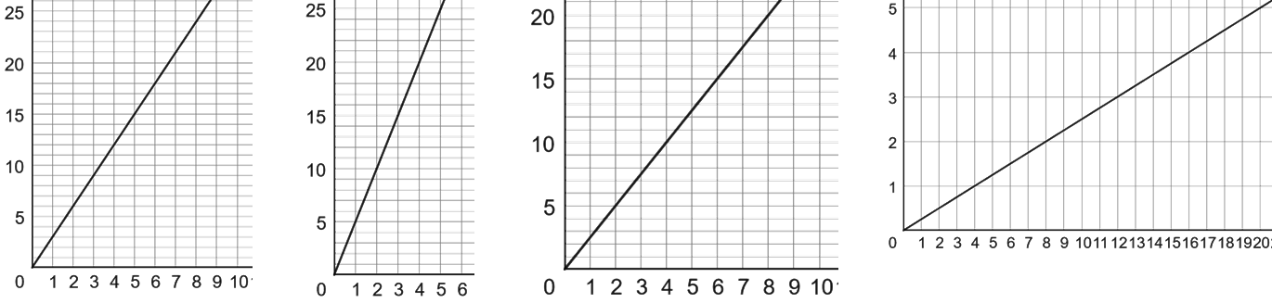
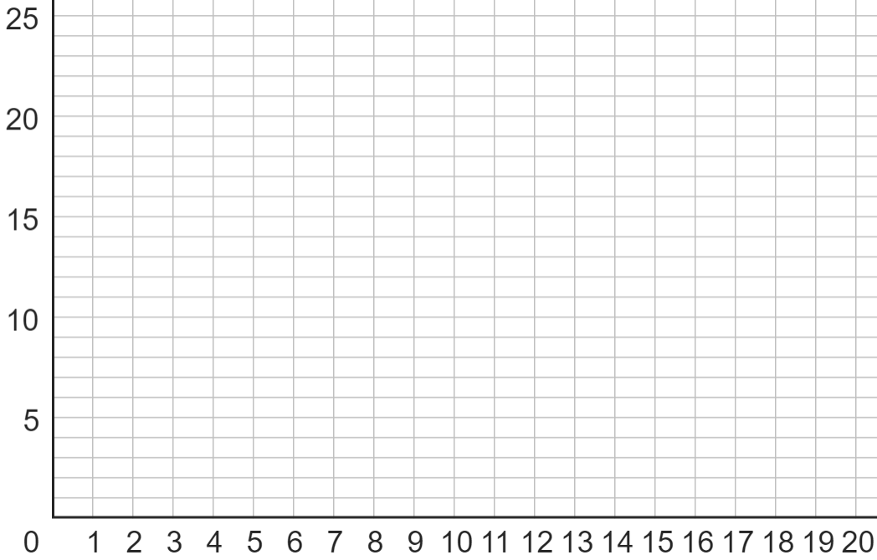
Multiplicative relationships and direct proportion
Task B: Graphing proportional relationships
1) Match each table to the correct graph and fill in the missing values:
A
B
C
D
2 | 5
7 | 17.5
3
8
2 | 6
5 | 15
3
4
4 | 1
6 | 1.5
8
16
3 | 15
7 | 35
2
5
2) The following all have a directly proportional relationship. Plot a graph of each.
a)
b)
2 | 6
3
4
6
4 | 2
8
12
16

Slide 4
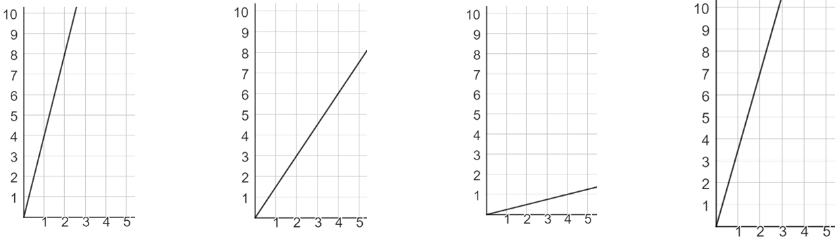
Multiplicative relationships and direct proportion
c)
1 | 1.5
2
4
8
3) Match each double number line to the correct graph:
y
A
y
B
y
C
y
D
x
x
x
x
2
4
x
1
4
x
0.5
4
x
2
5
x
y
y
y
y
7
14
0.25
1
0.75
6
8
20
Mathematics in Education and Industry
v2.3

